Slide 1


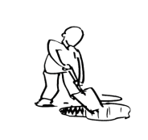



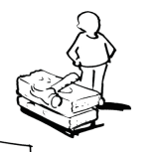
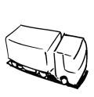


Business Model Canvas
Key Partners Key partners: Suppliers of high-quality materials, transportation, and logistics companies, skilled labor and fabrication subcontractors, and marketing and sales agencies. Key resources acquired from partners: High-quality materials, transportation and logistics services, fabrication expertise and labor, and marketing and sales support. Key activities partners perform fabricating and installing temporary structures, transportation and logistics support, marketing, and sales. | Key Activities Key activities: Design, engineering, fabrication, and installation of temporary structures, as well as maintenance and repair services. Distribution channels: Direct sales, website and online presence, social media, referrals, events, and trade shows. | Value Propositions Value delivered: High-quality, customizable temporary structures for various events, quick turnaround times, and reliable delivery. Problems solved: Customers need temporary structures for events, which can be expensive and time-consuming to build from scratch. Bundles of products and services: Customized design, engineering, fabrication, and installation of temporary structures, along with maintenance and repair services. Customer needs to be satisfied: High-quality, customizable structures that meet their specific event requirements, with reliable and quick service. |  | Customer Relationships They create value for event organizers and managers, airlines, and governments. Most important customers: Large event organizers and managers, government agencies, and airlines requiring temporary events and operations structures. | Customer Segments The main customer segments are event organizers, managers, airlines, and governments. Customers require high-quality, customizable temporary structures for various events. Customers are cost-sensitive but value quality and reliability. Integration with the rest of the model: Customers are the business’s primary revenue source, and key activities and resources are centered around meeting their needs.
 | Key Resources BuildAir relies heavily on building strong customer relationships to maintain repeat business and positive referrals. Revenue streams: BuildAir generates revenue from selling and maintaining temporary structures. Key resources: Skilled design and engineering personnel, high-quality fabrication equipment and materials, reliable transportation and logistics systems, and effective marketing and sales strategies. |  |  | Channels Channels used: Direct sales, website and online presence, social media, referrals, events, and trade shows. Integration: Channels are integrated with the rest of the model through targeted marketing and communication to reach and engage with the right customer segments.
Cost Structure The most important costs include skilled labor, high-quality materials, transportation and logistics, and marketing and sales efforts. Key resources such as skilled labor and high-quality materials are the most expensive. Key activities such as fabrication and installation can also be expensive due to the complexity of the structures and the need for specialized expertise. |  |  | Revenue Streams Customers are willing to pay for high-quality, reliable temporary structures that meet their specific event needs. Revenue streams come from the sale and maintenance of temporary structures, with additional potential for revenue from expanded services such as event planning and logistics support. Each revenue stream contributes to overall revenues depending on the size and complexity of the project.
http://www.businessmodelgeneration.com

Slide 2
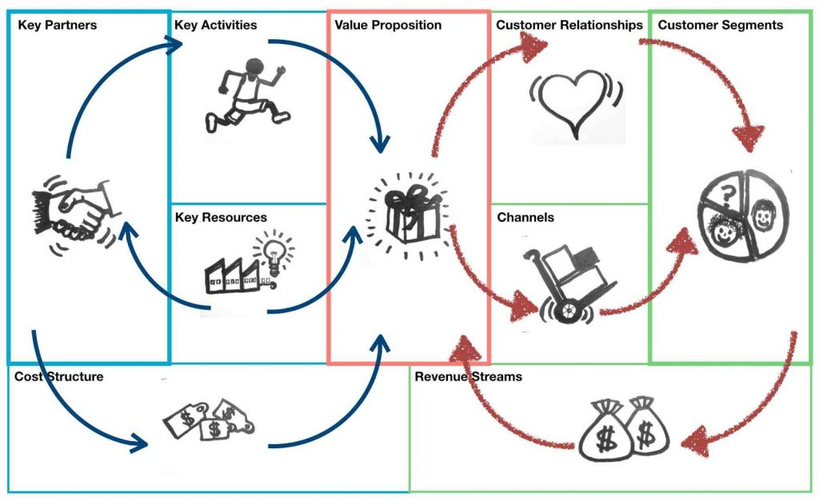
Business Model Canvas
7
2
1
5
4
6
3
9
8

